Slide 1
Lamp
Honour team 3:
Timothy van der Steenhoven
Saskia van der Velden
Emanuel Bakare

Slide 2
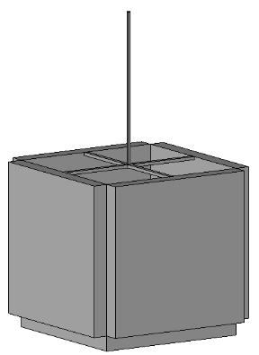
Lamp
Pieces from the doorlocks.
Lamp.
Give light and create a good mood.
See point 3.
In every space in a building.
Everyone that ones a building.
Everyone that ones a building a need or want a lamp.
A company that make lamps out of recycled material.

